Slide 1
Beer Reviews Data Analysis Project
By – Akshay Dhotre

Slide 2
Purpose of the project is to explore Beer reviews dataset and find answers to below questions -
Rank top 3 Breweries which produce the strongest beers?
Which year did beers enjoy the highest ratings?
Based on the user’s ratings which factors are important among taste, aroma, appearance, and palette?
If you were to recommend 3 beers to your friends based on this data which ones will you recommend?
Which Beer style seems to be the favorite based on reviews written by users?
How does written review compare to overall review score for the beer styles?
How do find similar beer drinkers by using written reviews only?

Slide 3
Tools used
Python 3.10.6
Python based open source libraries
Jupyter Notebook
Visual Studio Code
GitHub

Slide 4
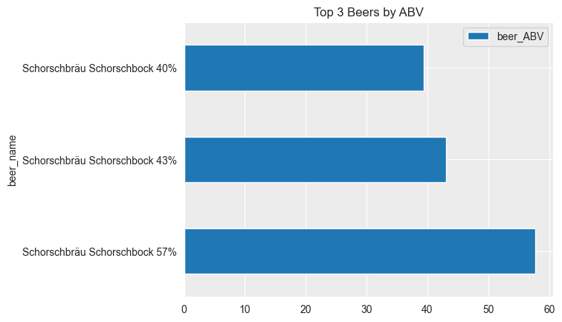
1. Rank top 3 Breweries which produce the strongest beers?
According to Wikipedia - The strength of beer is measured by its alcohol content by volume expressed as a percentage, that is to say, the number of milliliters of absolute alcohol (ethanol) in 100 mL of beer.
This parameter is called 'Alcohol by Volume' (ABV)
Strongest Beers by ABV are -
  Schorschbräu Schorschbock 57% Schorschbräu Schorschbock 43% Schorschbräu Schorschbock 40%

Slide 5
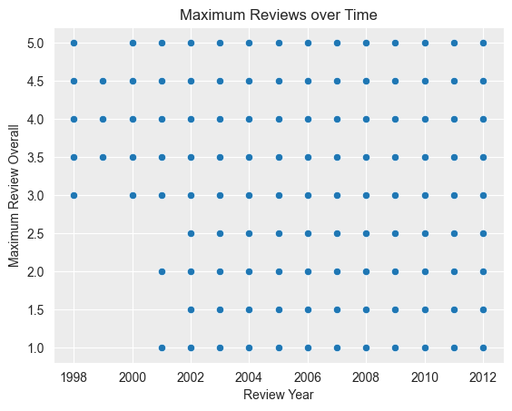
2. Which year did beers enjoy the highest ratings?
For this we need to extract 'year' information from 'review time' column.
After that we can group on 'beer name' and 'review year', then aggregate them on 'overall rating' with maximum rating
Some of highest rated beers with the year they rated highest are -
  Hop, Drop n Roll (2011)
  Cantillon Kriek 100% Lambic (2008)
  Slap & Tickle (2010)
  Hell For Certain (2004)
  Cantillon La Dernière Cuvée Du 899 (2008)

Slide 6
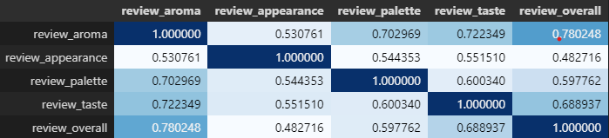
3. Based on the user’s ratings which factors are important among taste, aroma, appearance, and palette?
Here we need to calculate correlation of 'review_aroma', 'review_appearance', 'review_palette' and 'review_taste' with 'review_overall'
There is high correlation between Aroma and Overall review, after that Taste has high correlation.

Slide 7
4. If you were to recommend 3 beers to your friends based on this data which ones will you recommend?
To recommend 3 beers to my friends as I do not have experience and preference, I would first find most popular beers from data and then find highest rated beers among them.
This will increase chance that my recommendations will work for my friends. Also there is always a favor for famous things among public.
Top 3 recommendations from my side will be (with average rating) -
  Founders KBS (Kentucky Breakfast Stout) (4.4)
  Tröegs Nugget Nectar (4.39)
  Founders Breakfast Stout (4.3)

Slide 8
5. Which Beer style seems to be the favorite based on reviews written by users?
First method -
To find most favourite styles I collected all beer styles and maximum sentiment score from user rating and then selected beer styles with maximum sentiment score
Most Favourite Beer Styles with positive review sentiment only -
  Dubbel,
  Irish Red Ale,
  Belgian Strong Dark Ale,
  American Double / Imperial Stout,
  American Stout, Scotch Ale / Wee Heavy,
  Belgian Strong Pale Ale,
  Winter Warmer,
  American Amber / Red Lager

Slide 9
5. Which Beer style seems to be the favorite based on reviews written by users?
Second method -
To find most favorite styles I collected all beer styles and maximum sentiment score from user rating and overall rating, then selected beer styles with maximum of both scores
Most Favorite Beer Styles from positive sentiment and overall rating -
  American Amber / Red Lager,
  American Double / Imperial Stout,
  American Stout,
  Belgian Strong Dark Ale,
  Belgian Strong Pale Ale,
  Dubbel,
  Irish Red Ale,
  Scotch Ale / Wee Heavy,
  Winter Warmer

Slide 10
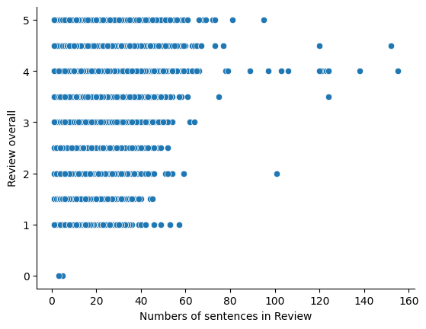
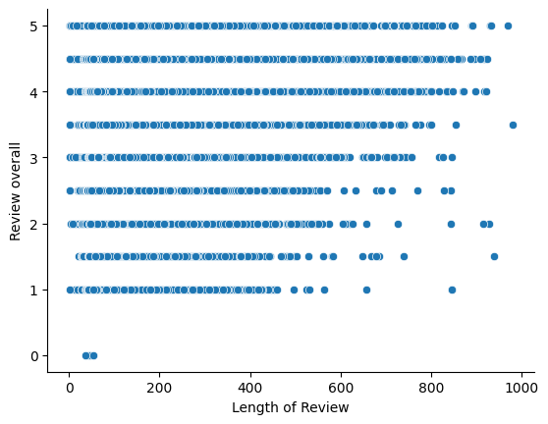
6. How does written review compare to overall review score for the beer styles?
From analysis of reviews written we can say that Positive reviews tend to me lengthy, and negative reviews are shorter in number of sentences as well as words

Slide 11
7. How do find similar beer drinkers by using written reviews only?
To find similar beer drinkers by oonly their reviews we can use -
  Content based filtering
  Collaborative filtering
Content based filters are used to make recommendations based on similar products/services according to their attributes
Collaborative filtering uses algorithms to filter data from user reviews to make personalized recommendations for users with similar preferences. With this we can find out similar beer drinkers.
Three types of collaborative filtering commonly used in recommendation systems are
  neighbor-based
  item-to-item and
  classification- based

Slide 12
Thank You!

